Slide 1
COMPACTO
Submitted in the partial fulfillment for the award of the degree of
BACHELOR OF ENGINEERING
IN
Computer Science Engineering (Mobile Computing)
Submitted by:
Abhigyan Prakash
Under the Supervision of:
Sir Yogiraj Anil Bhale
Department of AIT-CSE
DISCOVER . LEARN . EMPOWER

Slide 2
Outline
Introduction to Project
Problem Formulation
Objectives of the work
Methodology used
Results and Outputs
Conclusion
Future Scope
References

Slide 3
Introduction to Project
As the name suggests, “COMPACTO” itself defines the power of compressibility and compatibility within one single app which delivers you all the operations desirably.
This project came into existence for having problems like: -
Unable to keep notes from images.
Bloatware.
People who don’t understand a particular language.

Slide 4
Introduction to Project
The project predominantly aims to provide multiple functionalities in a single app.
Additionally, reduced bloatware helps the user to navigate through without an aid of any second person.
Navigation made easy!!

Slide 5
Problem Formulation
This Project came into existence because of following reasons: -
Online & offline mode
Speak out feature
Translate and extract in seconds

Slide 6
Problem Formulation
Few more stress-free areas like: -
Zero bloatware
Non natives
And of course multifunctional

Slide 7
Objectives
We’ve have come across to solve and highlight the features.
Speak out feature.
Real-time sign in feature.
Time Management.
Useful to anyone who keeps notes from images.

Slide 8
Methodology used
The methodology employed in the course of the project are outlined as follows: -
Outline a set of requirements to be met by the system proposed.
Use of concept of firebase Auth & firebase database.

Slide 9
Methodology used
Development of the solution system using firebase ML kit modules.
Detailed reporting of the findings stated above, with deduced inferences, and noted grounds for future innovation.

Slide 10
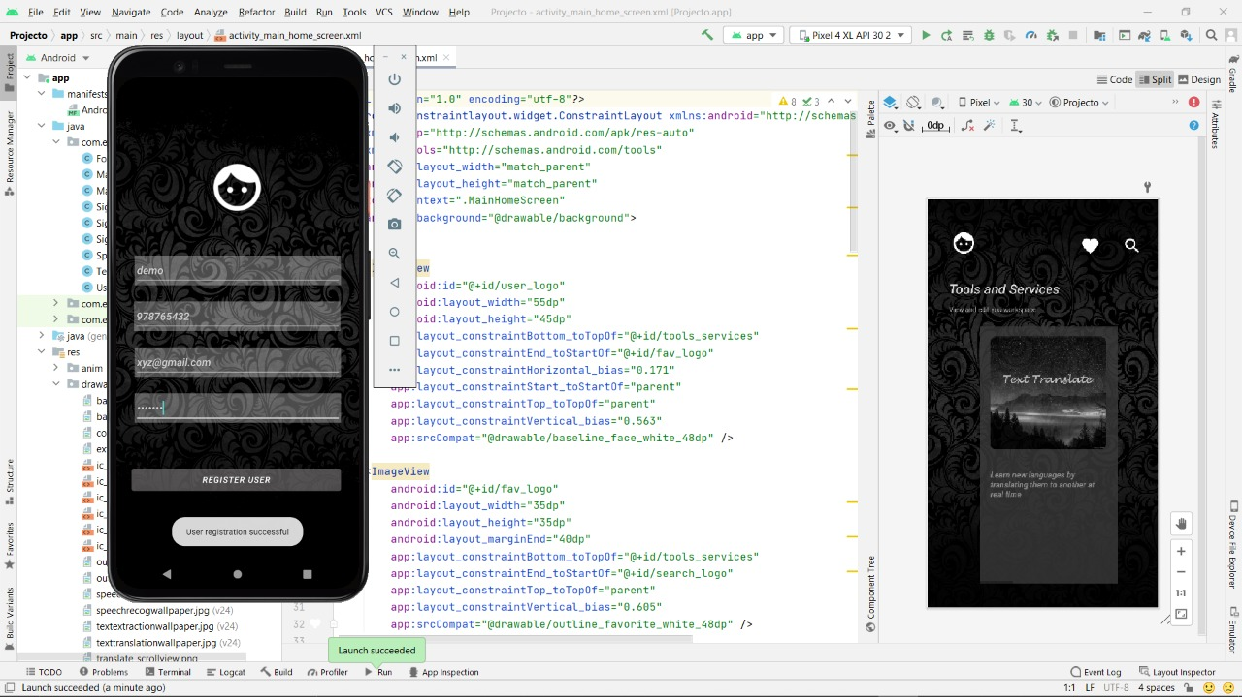
Results and Outputs

Slide 11
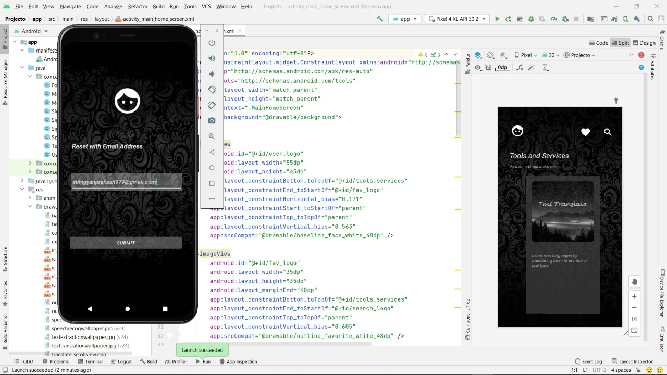
Results and Outputs

Slide 12

Results and Outputs

Slide 13
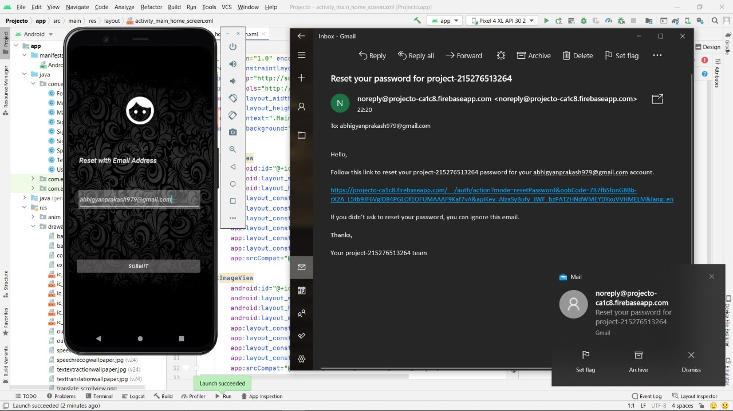
Results and Outputs

Slide 14
Results and Outputs

Slide 15
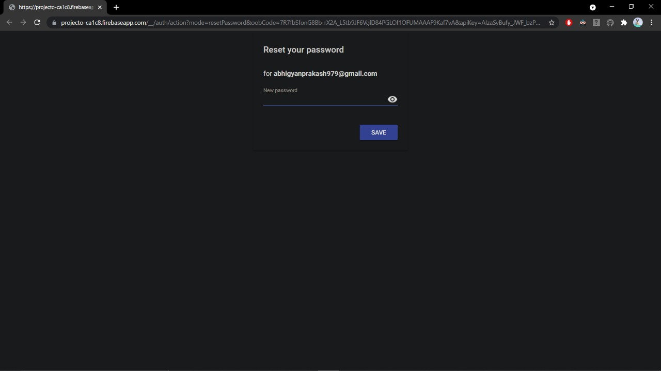
Results and Outputs

Slide 16
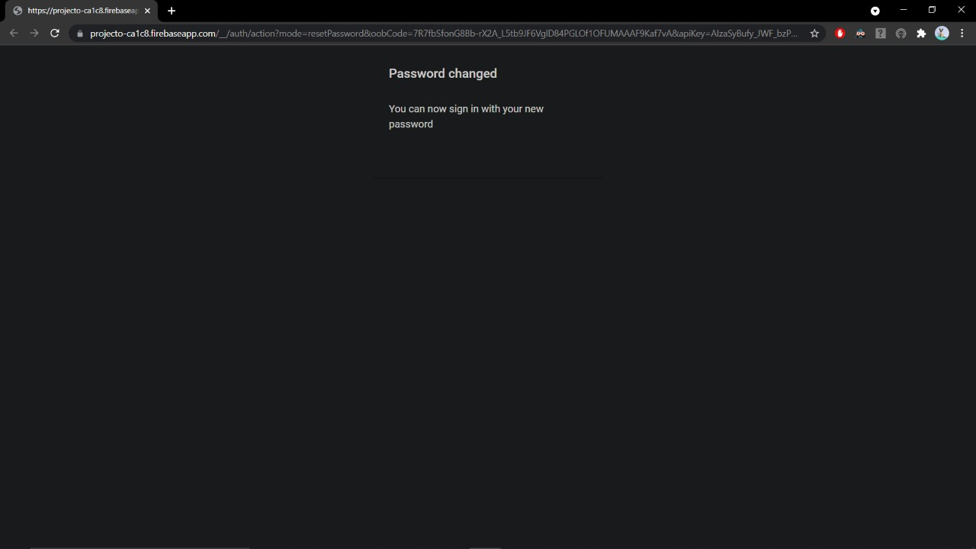
Results and Outputs

Slide 17
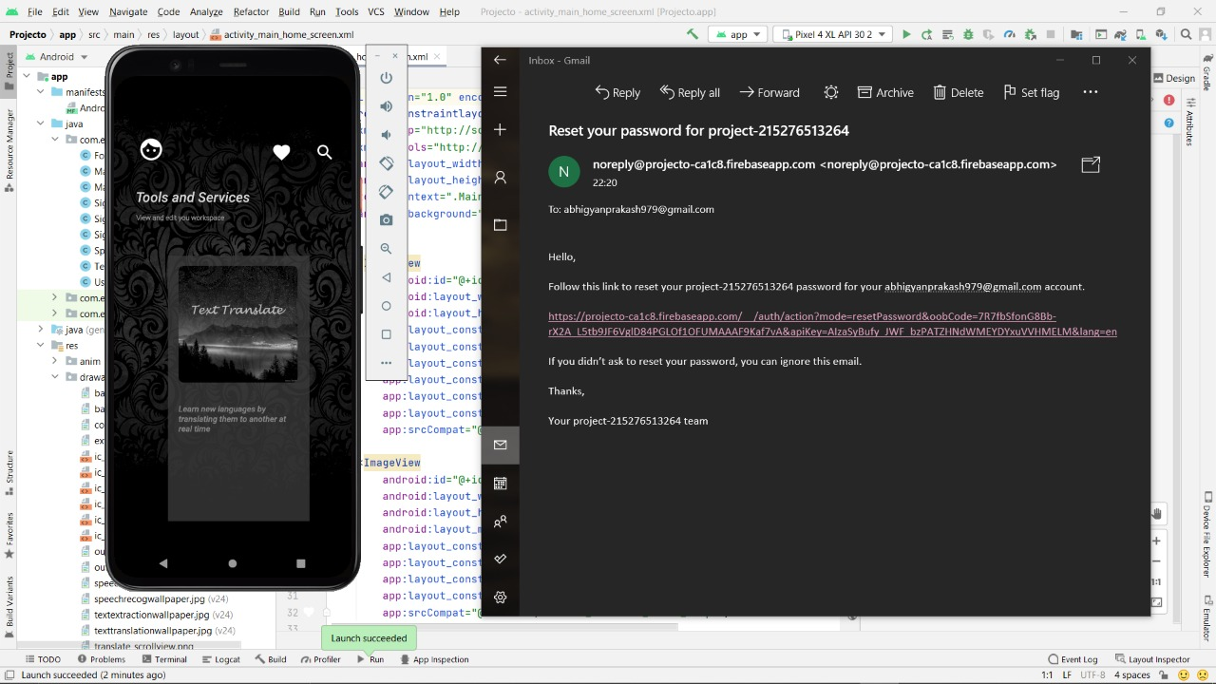
Results and Outputs

Slide 18

Results and Outputs

Slide 19
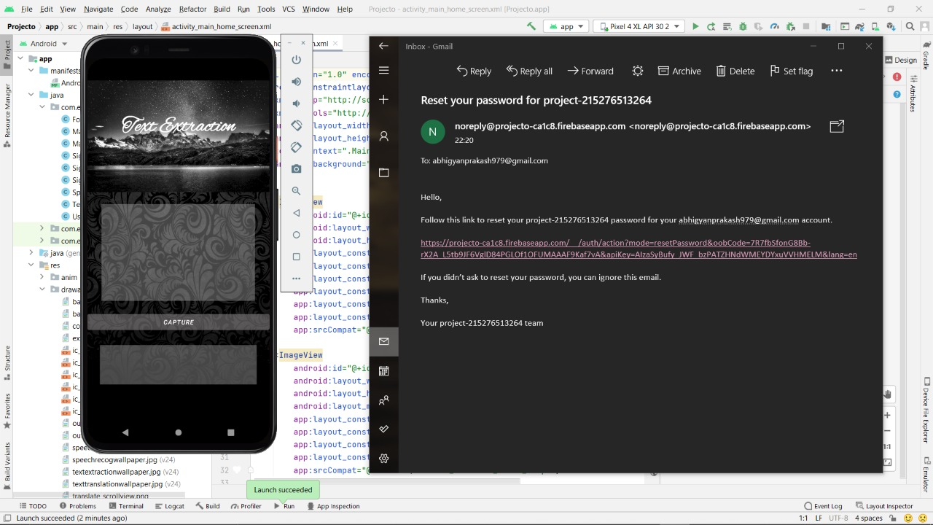
Results and Outputs

Slide 20
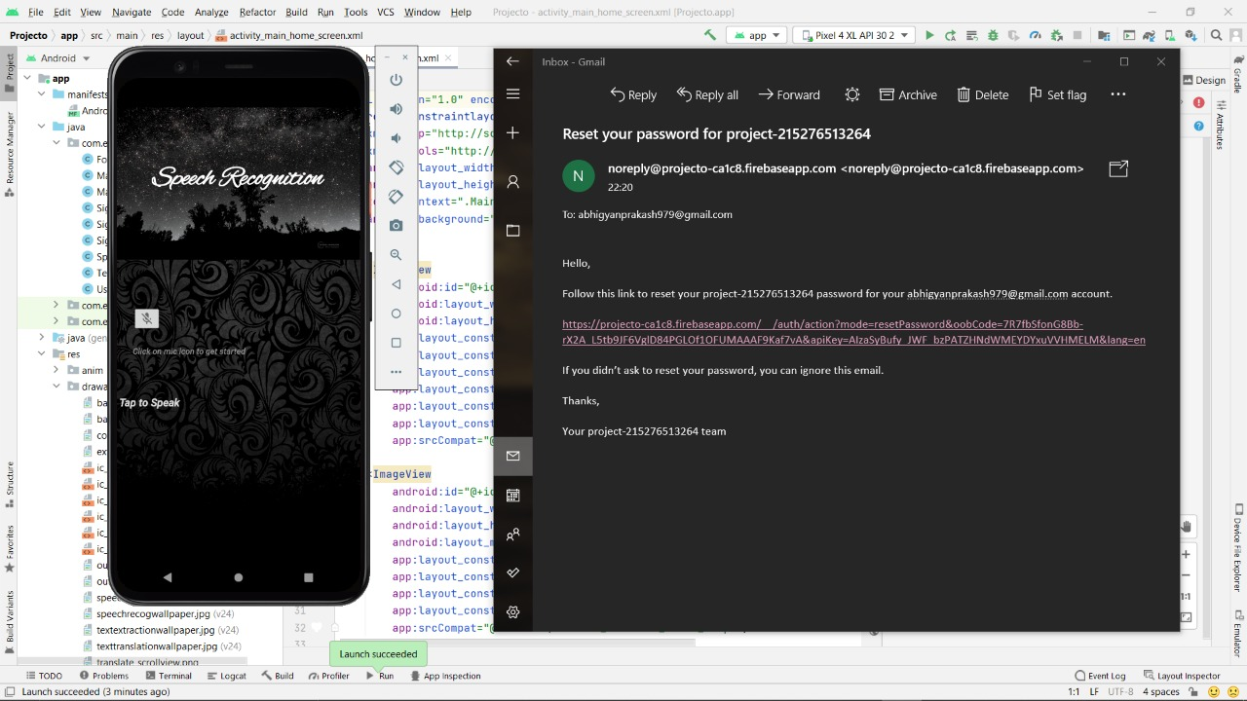
Results and Outputs

Slide 21
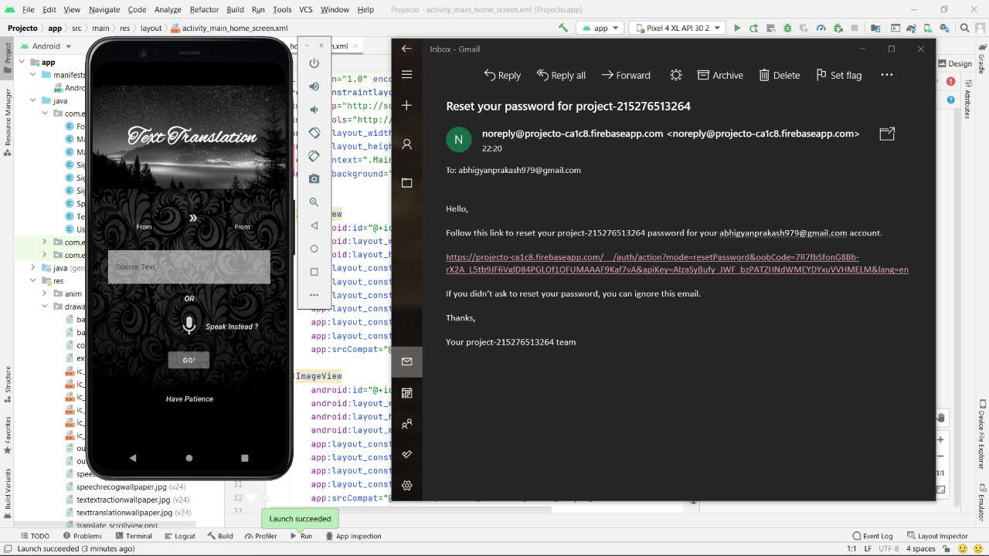
Results and Outputs

Slide 22

Results and Outputs

Slide 23
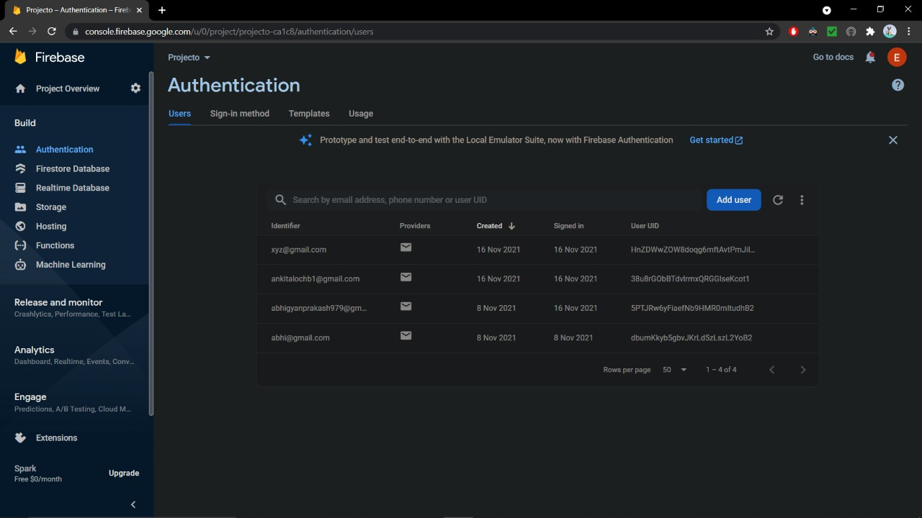
Results and Outputs

Slide 24
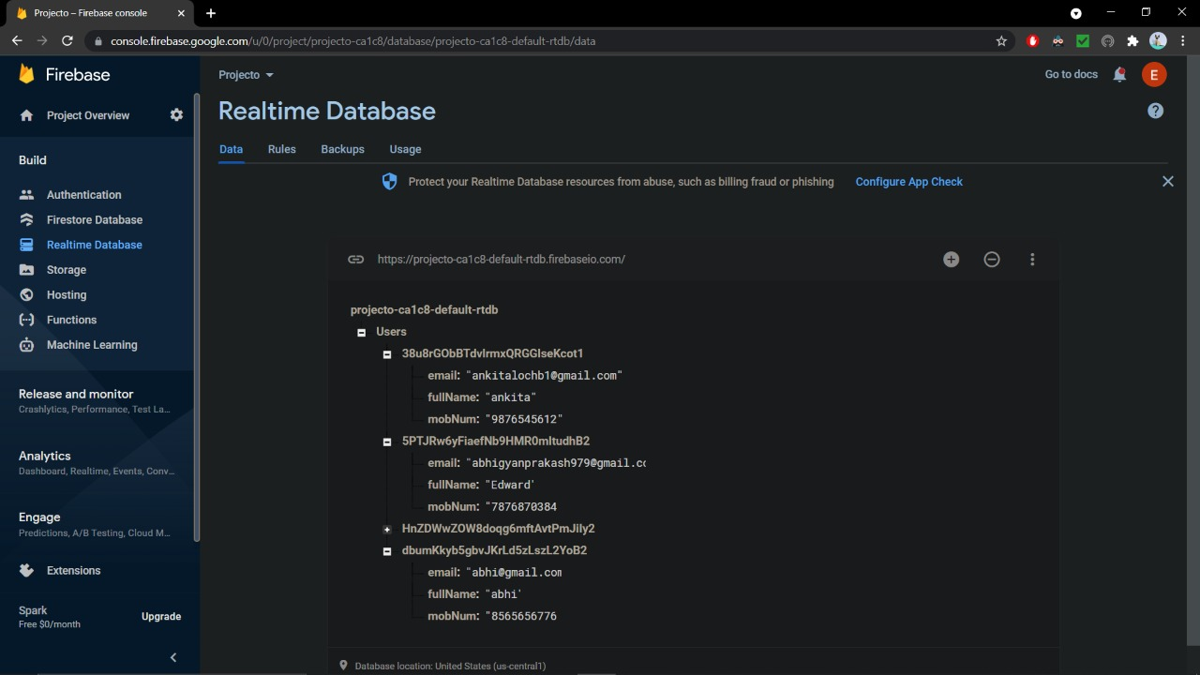
Results and Outputs

Slide 25
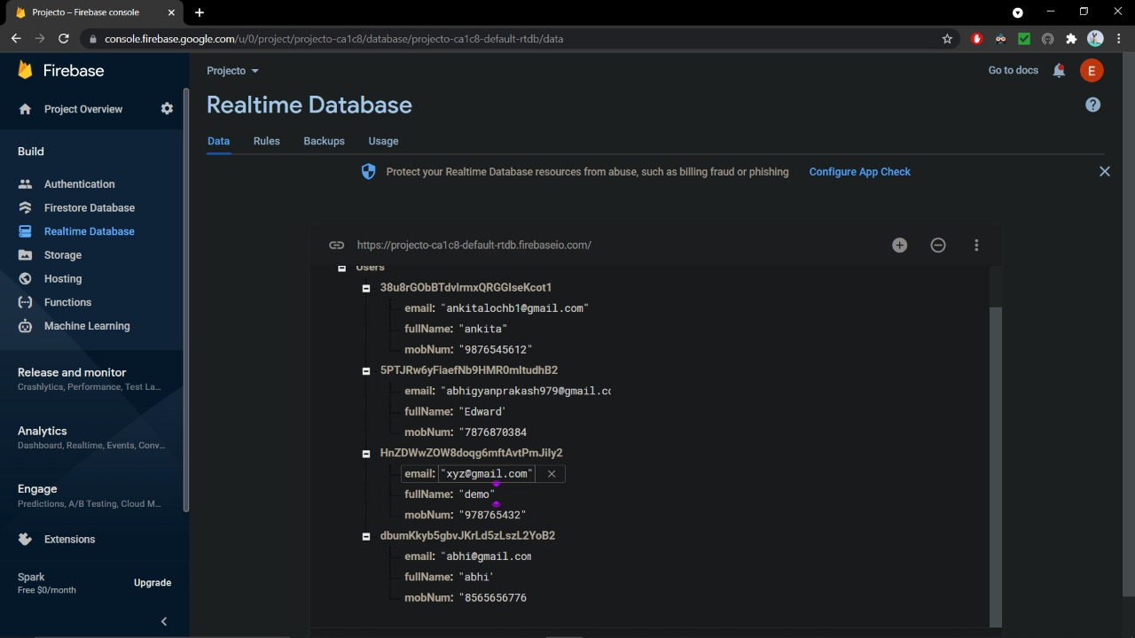
Results and Outputs

Slide 26
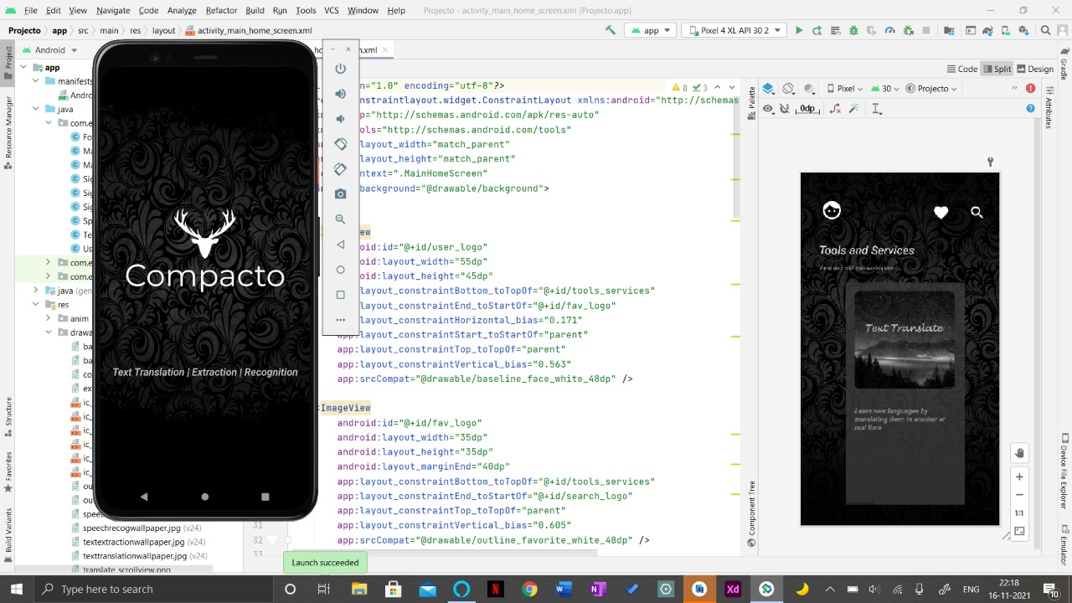
Results and Outputs

Slide 27

Results and Outputs

Slide 28
Conclusion
This app works smoothly above API level 21 i.e. android 5.
The existing apps had very few functionalities and with our proposed system we would be able to accomplish all the pitfalls in ordinary apps like Google Translator, Mobile OCR.

Slide 29
Future Scope
With an upgradation of fire store we would be able to save all the workspace to firebase database with respect to UID’s.
Having access to Wishlist where they can add most frequent words.
Introduction to Motion Layout.

Slide 30
References
For Database: -
https://firebase.google.com/docs/ml-kit
How to create variable, declare: -
https://developer.android.com/
For dependencies
https://console.firebase.google.com/u/0/

Slide 31
References
https://fonts.google.com/icons?selected=Material+Icons+Outlined:assignment_returned&icon.query=%5C+assignment
For dependencies:
https://google.github.io/material-design-icons/

